Slide 1
IVMOOC Project
Scientometric mapping of Interpreting
Lluís Baixauli-Olmos, lluis.baixauliolmos@Louisville.edu
University of Louisville (KY)

Slide 2
Meeting AGENDA
Greetings
What I’d like (ideally…)
Or else… (less ideal but equally cool)
Main problem
Q&A

Slide 3
What I’d LIKE (ideally…)
Main goal of project: To explore the evolution of the discipline of interpreting in terms of authors, publications, collaborations and topics over time and space.
Reference System (base map or maps): Worldmap, blank or other background (?)
Data overlays: Networks, authors over map; science map over worldmap; topics over science map
Deployment on interactive interface (HTML?)
Filters and visualization tabs
Search box
Time toggle

Slide 4
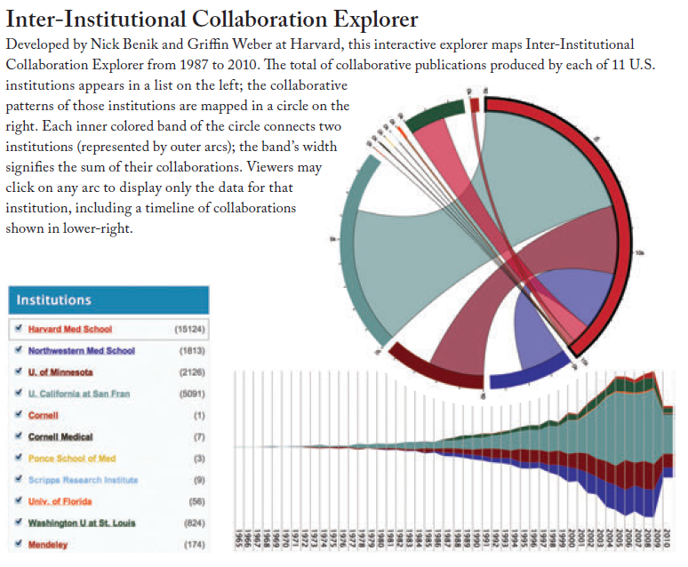
Filters
Atlas 2, p. 67
Institutions
Countries
Main topics
Main authors
Collaboration weights
Journals

Slide 5
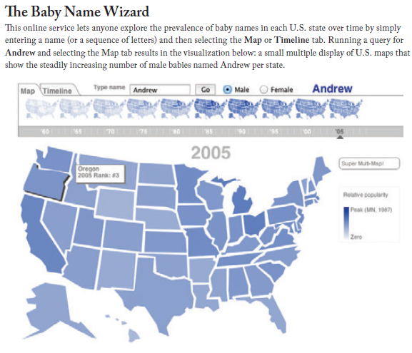
Visualization Tabs and Search Box
Atlas 2, p. 69

Slide 6
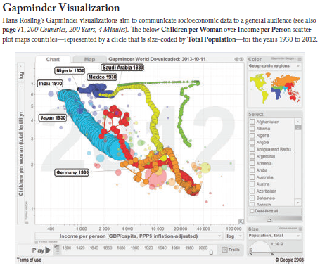
Time Toggle
Evolution of topics
Evolution of authors
Evolution of groups
Evolution of journals
Atlas 2, p. 65

Slide 7
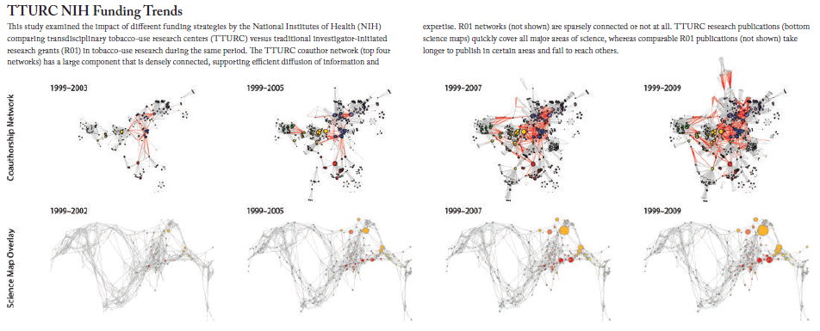
Overlaying
Authors, keywords, collaborations on geospatial map; geospatial to
Atlas 2, p. 65

Slide 8
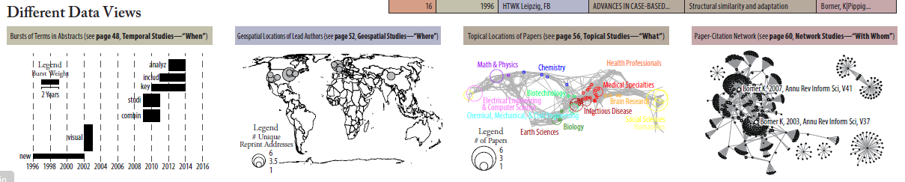
OR ELSE… (Less ideal but equally cool)
Atlas 2, p. 43

Slide 9
Main problemS WITH DATASET
No affiliation or geospatial information
This is fundamental for the planned visualization
Previous one had it, but too limited
No bibliography
Useful to do citation co-occurrence and author-topic visibility
What can we do?
I’m willing to be flexible. Suggestions are welcome!

Slide 10
Questions? Ideas? Proposals?
Collaboration: Scopus? Maybe Simona (IU.edu)
Simona (on dataset): DOI (why three numbers), accession number, store id, entry date
Chandan: integrating
NEW DATASET: 1. Going to Scopus database (Chandan or Simona with Lluís), 2. Searching for records in Interpreting Studies (and downloading), 3. Adding a Geolocation column (finding a geocoder that would process lots of records at once)

Slide 11
Thank you so very much!
Lluís Baixauli-Olmos, lluis.baixauliolmos@Louisville.edu
University of Louisville (KY)

